Slide 1
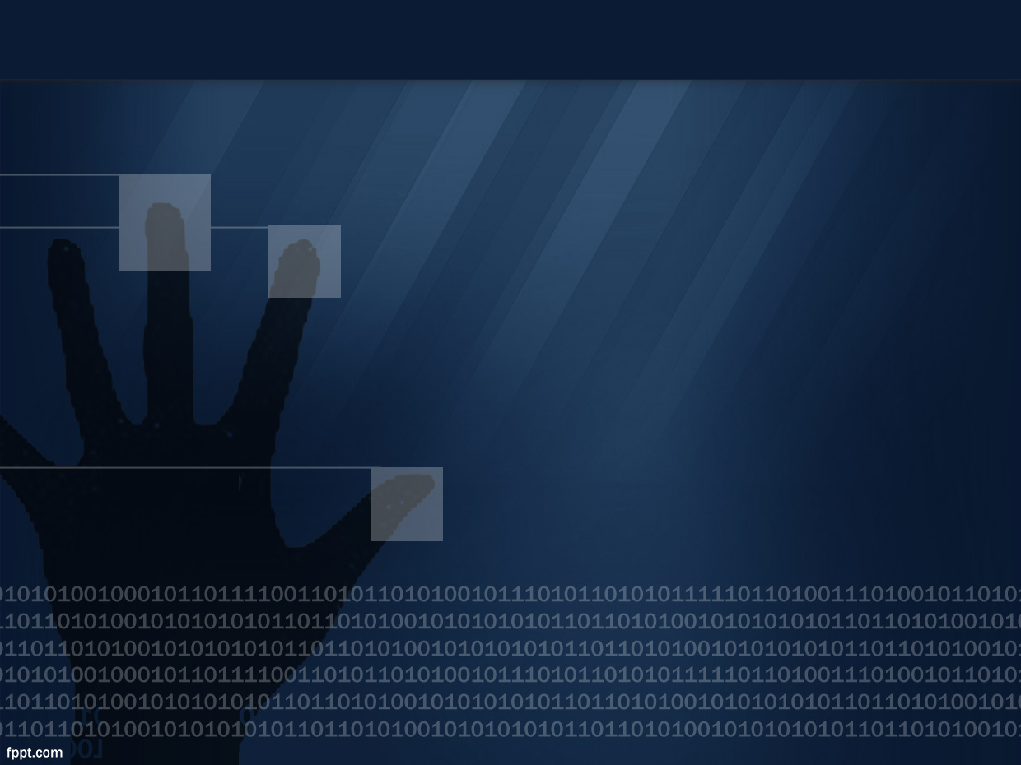
Khalilov M.
Twitter: @3ntr0py1337
https://github.com/entropy1337
Vulnerability Research
Fuzzing and Triaging with AFL

Slide 2

Agenda
Life Cycle of Vulnerability RnD
Why Fuzzing
Type of Fuzzing
AFL – Fuzzing thick clients
Demo
﻿

Slide 3
Life Cycle of RnD
Target Selection
Reconnaissance
Interface Selection
Corpus Creation
Fuzzing
Triaging
Exploit Development
Submission
﻿

Slide 4
Why Fuzzing
Pro:
Very fast iteration
can be smart and calculated
Can be fully automated
Cons:
Can miss good bugs
Can’t find logical bugs
﻿

Slide 5
Type of Fuzzing
Mutation Based / generation based – existing tools to modify the available sample data or feed random content
Dumb / Smart Fuzzing – Generate input with no structure or provide data which is expected by an application
White / Grey / Black Box Fuzzing
﻿

Slide 6
Dump vs Smart Fuzzing
﻿

Slide 7
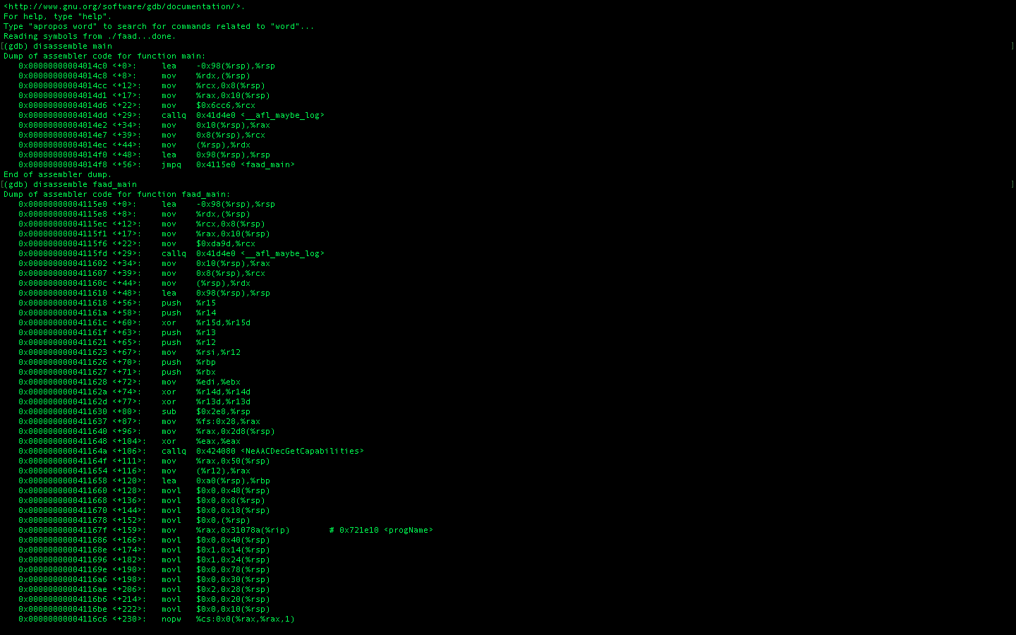
Dump vs Smart Fuzzing
#include <stdio.h>
int main()
{
char name[50];
printf("Enter your name:");
scanf("%s",&name);
if(len(name)==0)
{
printf("Try again");
}
else
{
printf("Your name is %s", name);
}
return 0;
}
﻿

Slide 8
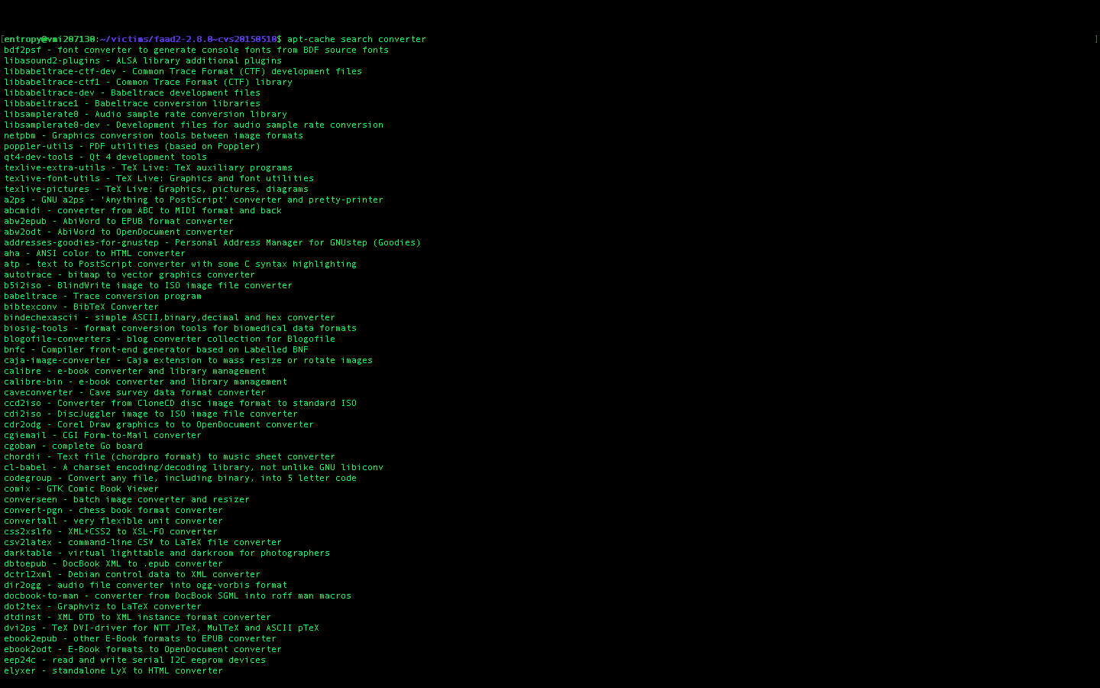
Demo – Finding targets

Slide 9
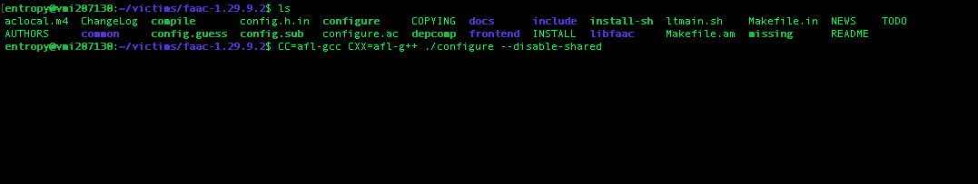
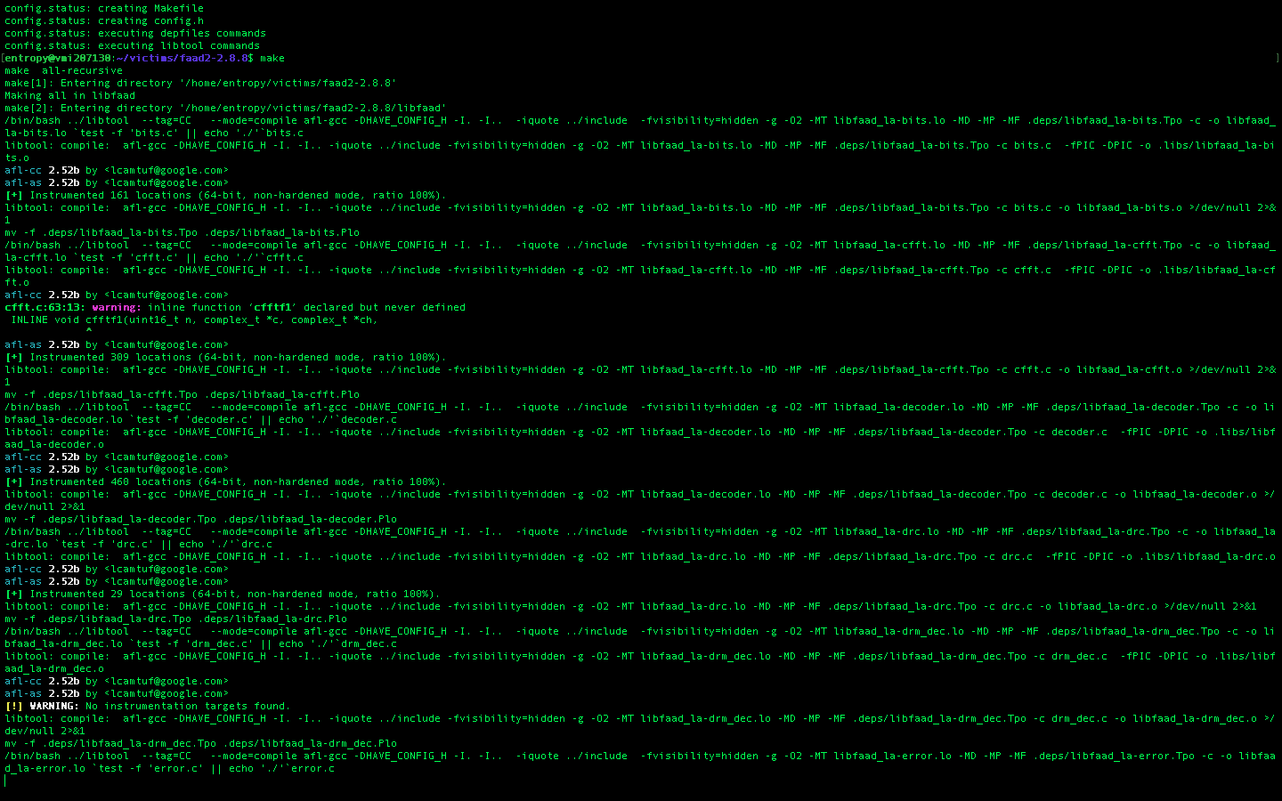
Instrumenting Target

Slide 10
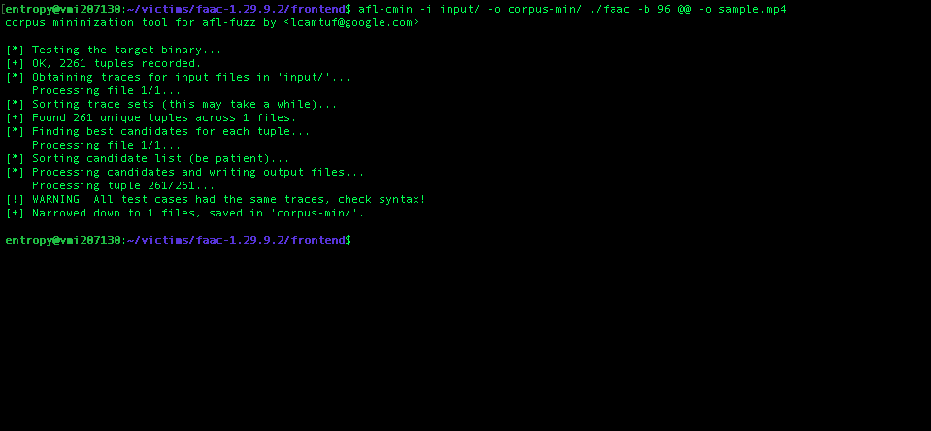
Corpus Minimization

Slide 11
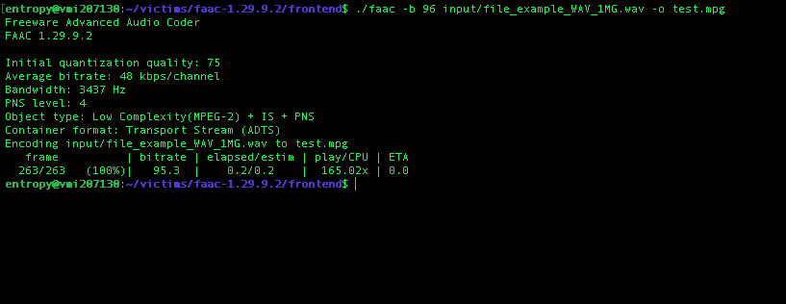
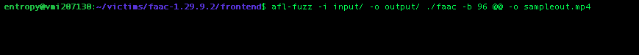
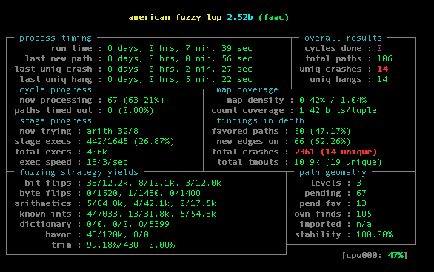
Interface Selection

Slide 12
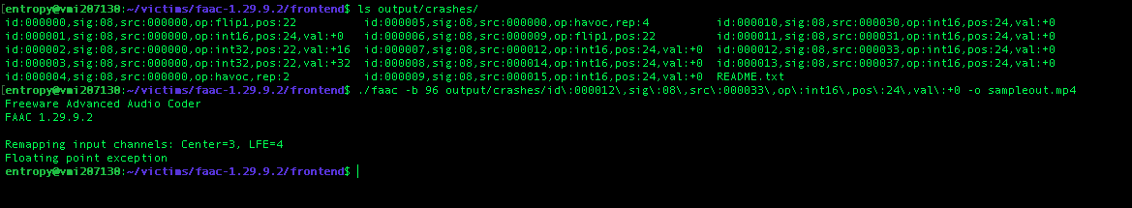
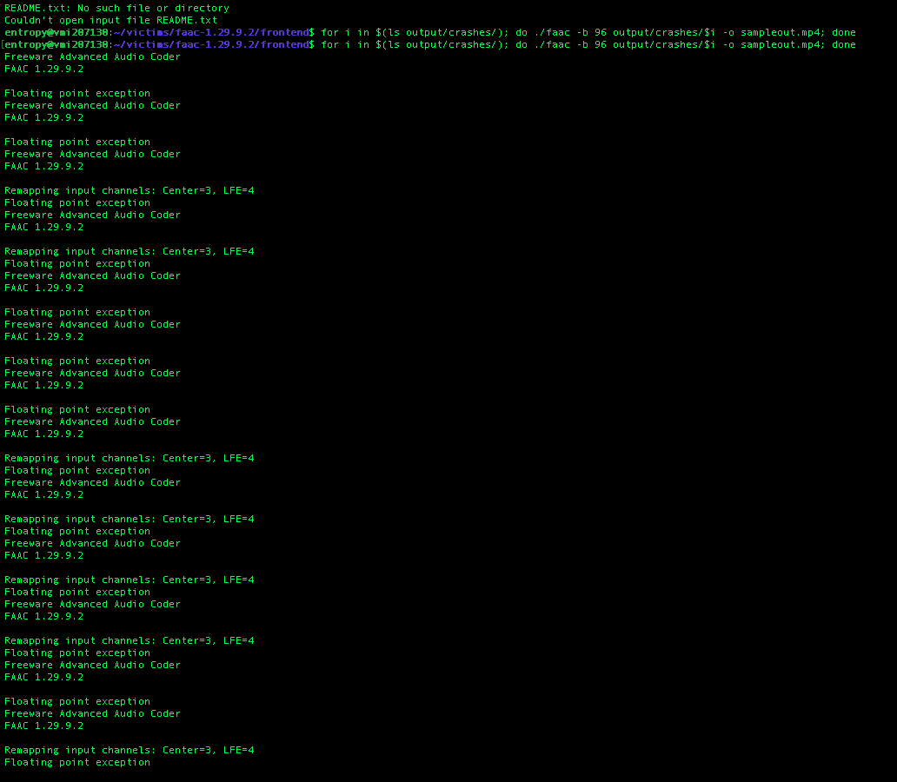
Crash Identification

Slide 13
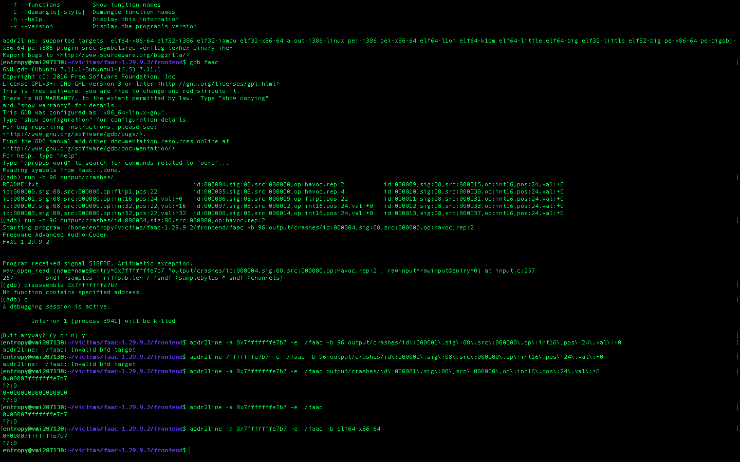
Triaging

Slide 14
References
https://github.com/ThalesIgnite/afl-training
http://lcamtuf.coredump.cx/afl/
https://fuzzing-project.org/tutorial3.html

Slide 15
Zero Day Research - More
Windows Thick Clients
CLI / GUI based application
Thin Clients
Libraries
Interpreted Programming Languages
Web Browsers
Kernel IOCTL

